Slide 1


INTRO TO WEB PROGRAMMING:
CONCEPTS AND TOOLS

Slide 2









Matt Charron
Director, Business Dev &
Technical Project Management
Paul Duffy
Vice President,
Software Engineering
10+ years of industry experience
Focused on Tools, UX, and Project Management
First learned to fix computers at age 11 after breaking home PC before my dad got home and noticed.
16+ years of industry experience
Focused on Web & Software Development and Project Management
Started programming at the age of 9

Slide 3

Artifex Technology Consulting, Inc.
Established in 2002
World Wide Client Base
Team of Developers, Designers, and Management/Support
Microsoft Certified Partner
Focused on Web Based, Custom Software Development
Work with ASP.NET, PHP, JavaScript, Python, Etc.

Slide 4
Overview / Agenda
Brief History & Overview of Website Creation (Starting in the mid 1990's)
Basic static HTML
Introduction of stylesheets
Evolution of web standards
Introduction to Responsive Web Design and Frameworks
Tools: IDE
What is VS Code?
Why use VS Code?
How to get VS Code?
What do I do after I install VS Code?
How to use VS Code and some of the cool features it provides
Creating a Basic Website with VS Code
Components of a Basic Website
Organization of file / folder structure
Tools and Helpers to streamline site creation
Putting it all together
CMS (Content Management Systems)
Why is HTML/CSS Still Important?

Slide 5
Common Key Terms and Technologies
HTML / ASP.NET / PHP / Javascript / jQuery - Programming Languages
CSS (Cascading Styling Sheets) – Cascading Style Sheets (CSS) is a simple mechanism for adding style (e.g., fonts, colors, spacing) to Web documents.
Responsive Web Design - An approach to web design aimed at crafting sites to provide an optimal viewing and interaction experience—easy reading and navigation with a minimum of resizing, panning, and scrolling—across a wide range of devices (from desktop computer monitors to mobile phones).
Frameworks – A set of elements, including HTML, CSS, JS and more, which are used to provide streamlined implementation options for developers and designers.
IDE (Integrated Development Environment) - A set of programming tools for writing applications (source code editor, compiler, debugger, etc.), all activated from a common user interface and menus.
Package Managers - A package manager or package management system is a collection of software tools that automates the process of installing, upgrading, configuring, and removing software packages for a computer 's operating system in a consistent manner.
CMS (Content Management System) - A computer or web application designed to manage digital content using an intuitive GUI without needing to be a developer or web designer.

Slide 6
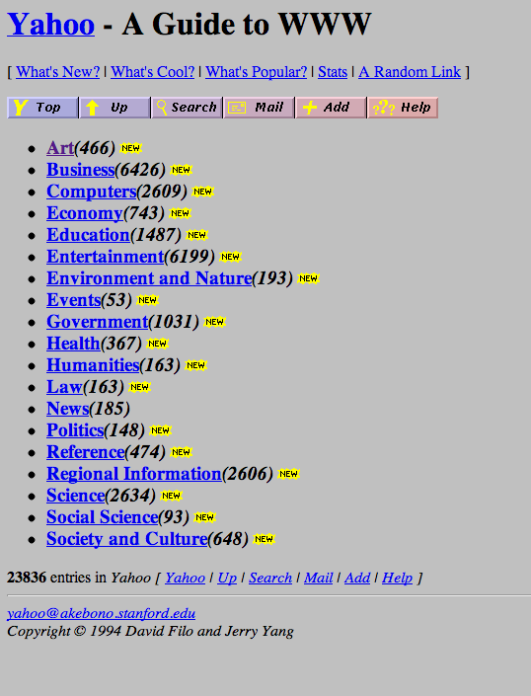
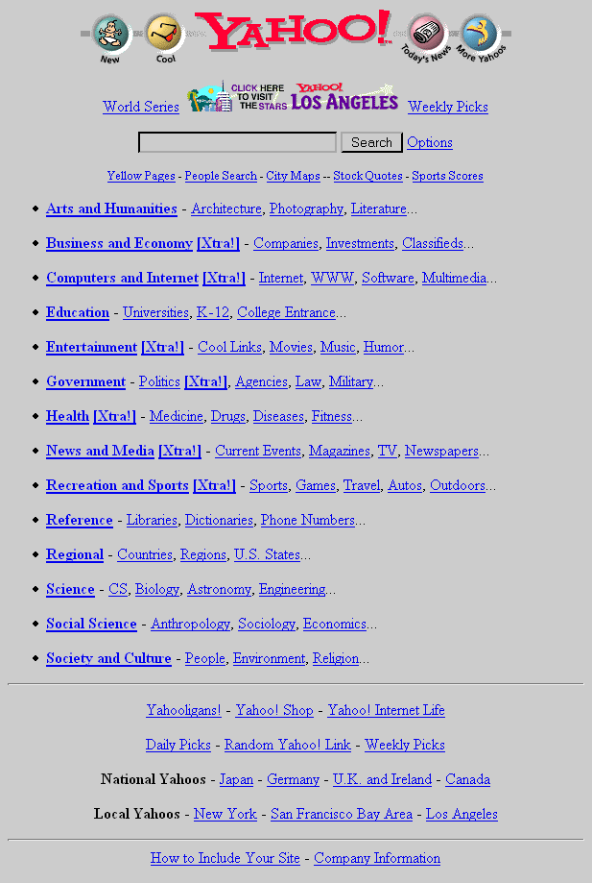
Early Public Websites (Yahoo.com)

Slide 7
Early HTML Tags
<!--> Comment <~&lt> Escape Sequences <A> Anchor <ADDRESS> Address <B> Bold <BASE> Base <BLOCKQUOTE> Block Quote <BODY> Body <BR> Line Break <CITE> Citation <CODE> Code <DIR> Directory List <DL> Definition List <EM> Emphasized
<FORM> Form
<H1> Heading 1 <H2> Heading 2 <H3> Heading 3 <H4> Heading 4 <H5> Heading 5 <H6> Heading 6
<HEAD> Head <HR> Horizontal Rule <HTML> HTML <I> Italic <IMG> Inline Image <INPUT> Form Input <ISINDEX> Is Index <KBD> Keyboard <LI> List Item <LINK> Link <LISTING> Listing
<MENU> Menu List <META> Meta
<OBJECT> Object <OL> Ordered List <P> Paragraph <PLAINTEXT> Plain Text <PRE> Preformatted Text <SAMP> Sample <SELECT> Form Select <STRIKE> Strikethrough
<STRONG> Strong <TEXTAREA> Form Text Area <TITLE> Title <TT> Teletype <U> Underlined <UL> Unordered List <VAR> Variable <XMP> Example

Slide 8
HTML Element Styling
<font size="3" color="red">This is some text!</font> <font size="2" color="blue">This is <b>some</b> text!</font> <font face="verdana" color="green">This is some text!</font>

Slide 9
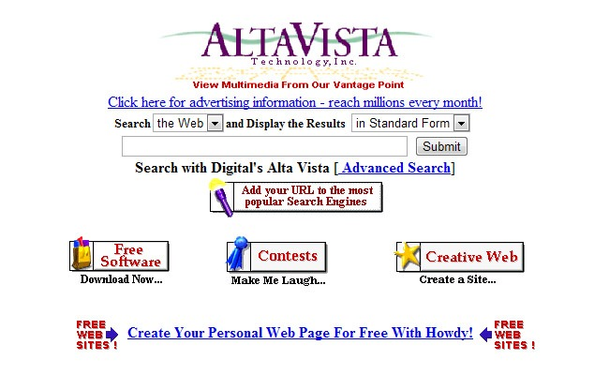
HTML Element Styling

Slide 10
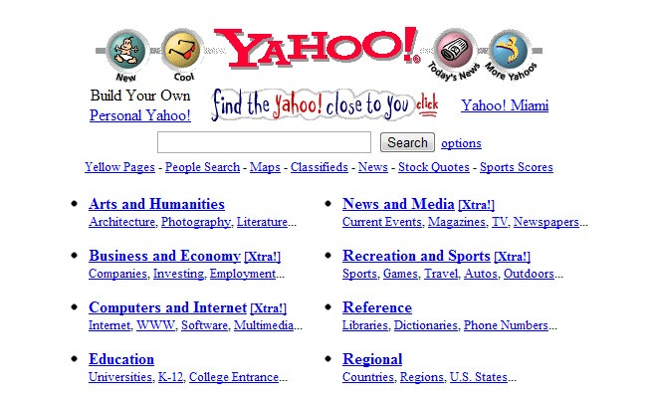
CSS
(Cascading Style Sheets)
Cascading Style Sheets (CSS) is a simple mechanism for adding style (e.g., fonts, colors, spacing) to Web documents.
A cascading style sheet (CSS) contains style rules that are applied to elements in a Web page. CSS styles define how elements are displayed and where they are positioned on the page. Instead of assigning attributes to each element on your page individually, you can create a general rule that applies attributes whenever a Web browser encounters an instance of an element or an element that is assigned to a certain style class.
In the early days CSS was not fully supported across all major browsers. Formatting that was supported could also be supported in different ways between browsers. This was a major headache for web designers and developers.

Slide 11
Implementing CSS
Internal Stylesheet
External Stylesheet
This way you are simply placing the CSS code within the <head></head> tags of each HTML file you want to style with the CSS. The format for this is shown in the example below.
<head> <title><title> <style type=”text/css”> CSS Content Goes Here </style> </head> <body>
An external CSS file can be created with any text or HTML editor. A CSS file contains no HTML, only CSS. You simply save it with the .css file extension. You can link to the file externally by placing a link in the head section of every HTML file you want to style with the CSS file. <head> <title><title> <link rel=”stylesheet” type=”text/css” href=“Path To stylesheet.css” /> < /head>

Slide 12
Implementing CSS
Sample CSS:
html, body {
margin: 0px; padding: 0px; border: 0px; color: #000; background: #fff;
}
html, body, p, th, td, li, dd, dt {
font: 1em Arial, Helvetica, sans-serif;
}
h1, h2, h3, h4, h5, h6 {
font-family: Arial, Helvetica, sans-serif;
}
h1 {
font-size: 2em;
}
h2 {
font-size: 1.5em;
}
a:link {
color: #00f;
}

Slide 13
Implementing CSS
Demo Time:
Basic CSS In Action
Today’s CSS examples can be viewed on CodePen:
No CSS: http://codepen.io/MCharron/pen/RGdqrv
CSS: http://codepen.io/MCharron/pen/jrJQkq

Slide 14
Evolution of CSS Standards
CSS 1 -
The first CSS specification to become an official W3C Recommendation is CSS level 1, published on December 17, 1996. Håkon Wium Lie and Bert Bos are credited as the original developers. Among its capabilities are support for:
Font properties such as typeface and emphasis
Color of text, backgrounds, and other elements
Text attributes such as spacing between words, letters, and lines of text
Alignment of text, images, tables and other elements
Margin, border, padding, and positioning for most elements
Unique identification and generic classification of groups of attributes
CSS 2 -
CSS level 2 specification was developed by the W3C and published as a recommendation in May 1998. A superset of CSS 1, CSS 2 includes a number of new capabilities like absolute, relative, and fixed positioning of elements and z-index, the concept of media types, support for aural style sheets (which were later replaced by the CSS 3 speech modules) and bidirectional text, and new font properties such as shadows.
CSS 3 -
Unlike CSS 2, which is a large single specification defining various features, CSS 3 is divided into several separate documents called "modules". Each module adds new capabilities or extends features defined in CSS 2, preserving backward compatibility. Work on CSS level 3 started around the time of publication of the original CSS 2 recommendation. The earliest CSS 3 drafts were published in June 1999.
Due to the modularization, different modules have different stability and statuses. As of June 2012, there are over fifty CSS modules published from the CSS Working Group., and four of these have been published as formal recommendations:
2012-06-19: Media Queries
2011-09-29: Namespaces
2011-09-29: Selectors Level 3
2011-06-07: Color

Slide 15
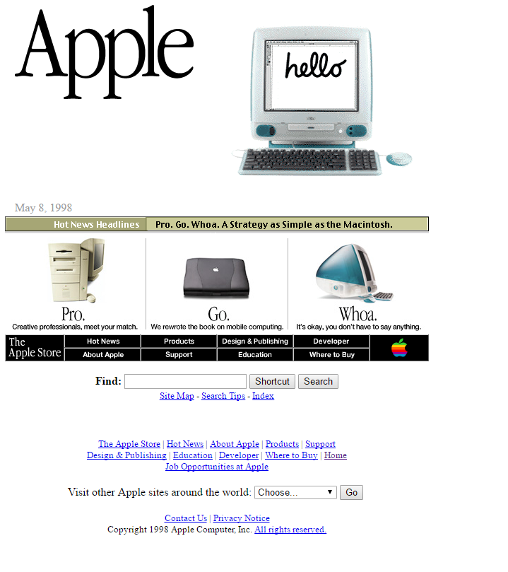
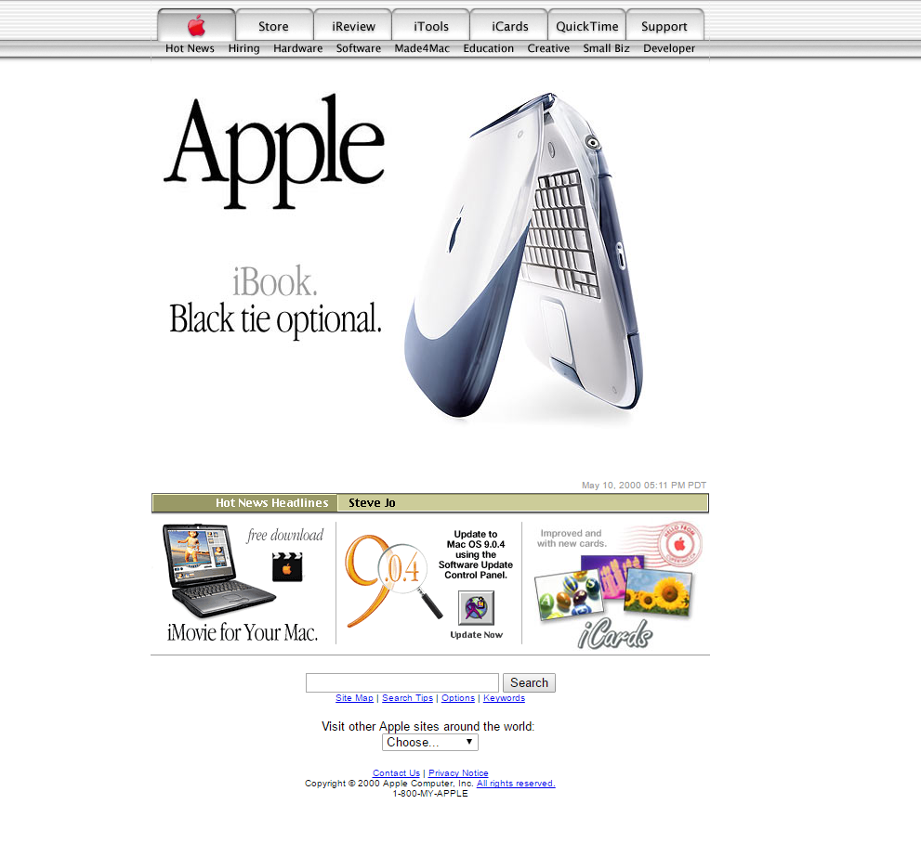
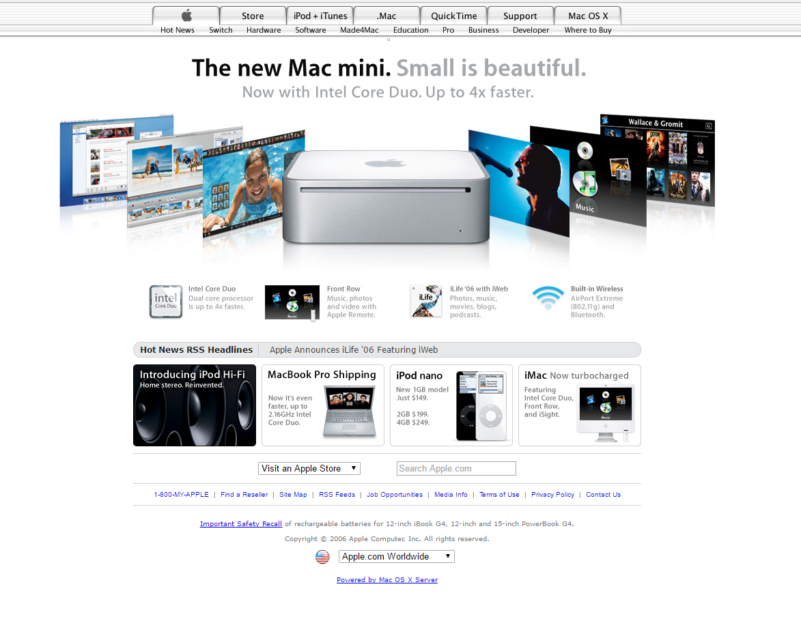
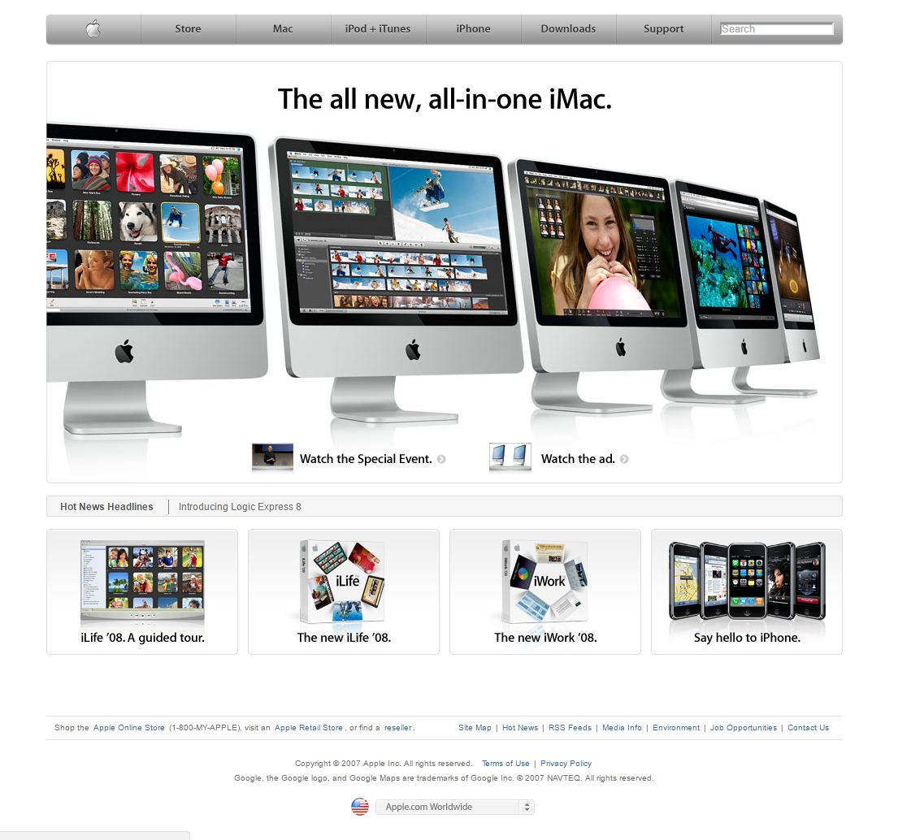
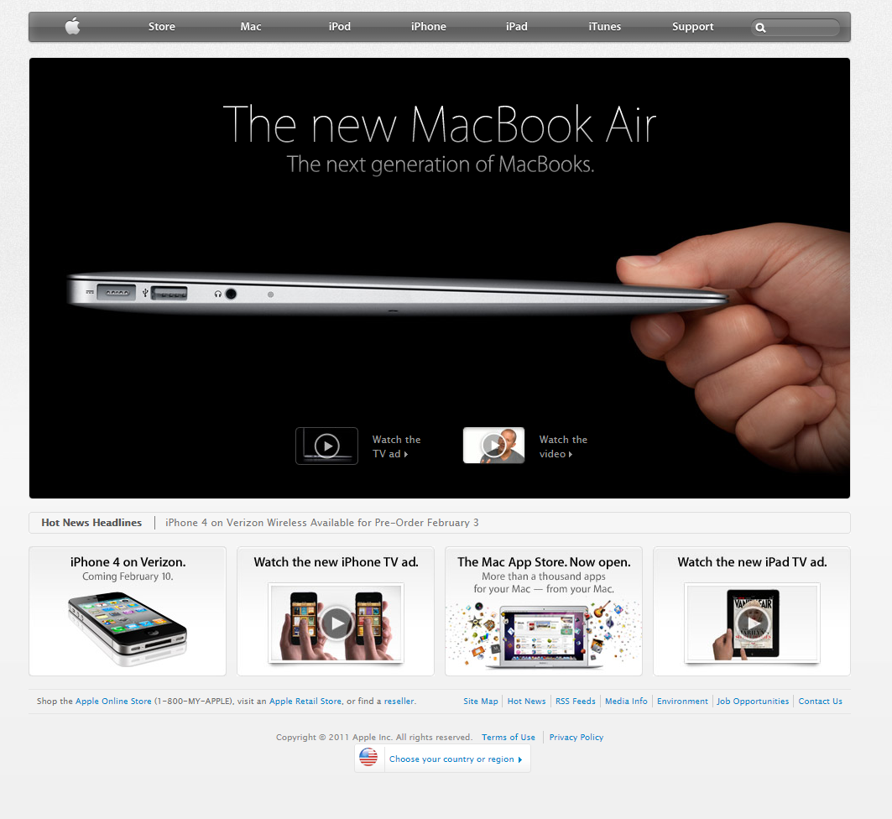
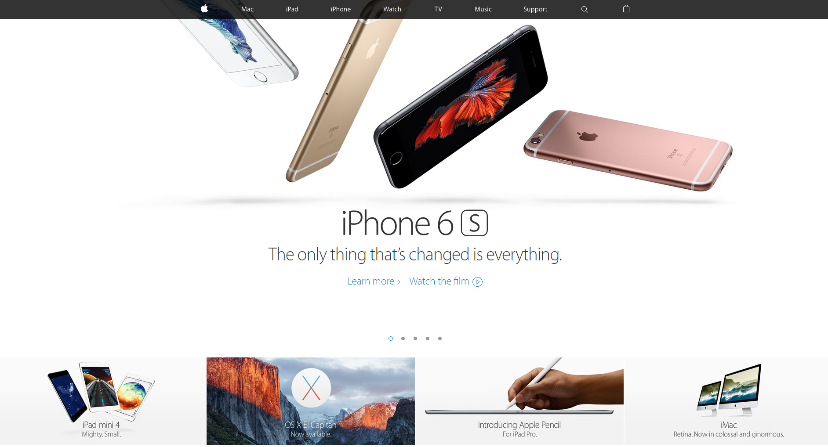

Slide 16
June, 2007
Something New!

Slide 17

The iPhone

Slide 18
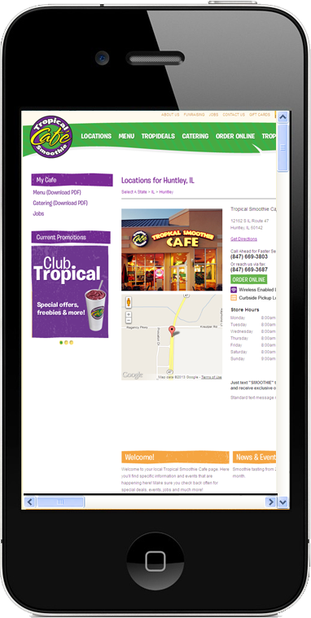
Something New
(To Worry About)
Full Featured Web Browser
Slower data connection speeds
Limited screen real estate
Different user interactions (touch)

Slide 19

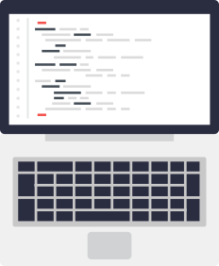
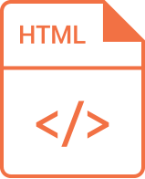
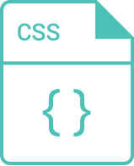

Solution 1: Dedicated Mobile Websites
Desktop Site: www.example.com
+
Create Desktop Content
Write Separate HTML / CSS
Desktop Content, Desktop URLs
Mobile Site: m.example.com
+
Create Mobile Content
Write Separate HTML / CSS
Mobile Content, Mobile URLs

Slide 20
Solution 1: Dedicated Mobile Websites
Double work to create
Double work to maintain
Increased chances of mistakes

Slide 21
There has to be a better way!

Slide 22
Common Key Terms and Technologies
HTML / ASP.NET / PHP / Javascript / jQuery - Programming Languages
CSS (Cascading Styling Sheets) – Cascading Style Sheets (CSS) is a simple mechanism for adding style (e.g., fonts, colors, spacing) to Web documents.
Media Queries – A CSS3 Module / Standard that allows content rendering to adapt to conditions such as screen resolution.
Responsive Web Design - An approach to web design aimed at crafting sites to provide an optimal viewing and interaction experience—easy reading and navigation with a minimum of resizing, panning, and scrolling—across a wide range of devices (from desktop computer monitors to mobile phones).
Frameworks – A set of elements, including HTML, CSS, JS and more, which are used to provide streamlined implementation options for developers and designers.
IDE (Integrated Development Environment) - A set of programming tools for writing applications (source code editor, compiler, debugger, etc.), all activated from a common user interface and menus.
Package Managers - A package manager or package management system is a collection of software tools that automates the process of installing, upgrading, configuring, and removing software packages for a computer 's operating system in a consistent manner.
CMS (Content Management System) - A computer or web application designed to manage digital content using an intuitive GUI without needing to be a developer or web designer.

Slide 23
Solution 2: Responsive Design Websites
Responsive Web design is the approach that suggests that design and development should respond to the user’s behavior and environment based on screen size, platform and orientation. The practice consists of a mix of flexible grids and layouts, images and an intelligent use of CSS media queries. As the user switches from their laptop to iPad, the website should automatically switch to accommodate for resolution, image size and scripting abilities. In other words, the website should have the technology to automatically respond to the user’s preferences. This would eliminate the need for a different design and development phase for each new gadget on the market.
Source: https://www.smashingmagazine.com/2011/01/guidelines-for-responsive-web-design/

Slide 24
Evolution of CSS Standards
Media Queries – A CSS3 Module / Standard that allows content rendering to adapt to conditions such as screen resolution.
A media query consists of a media type and one or more expressions, involving media features, which resolve to either true or false. The result of the query is true if the media type specified in the media query matches the type of device the document is being displayed on and all expressions in the media query are true. When a media query is true, the corresponding style sheet or style rules are applied, following the normal cascading rules.
@media screen and (min-width:500px) { ... }
Learn More: http://www.w3schools.com/cssref/css3_pr_mediaquery.asp

Slide 25
Implementing CSS
Demo Time:
Adding Media Queries to Our CSS
This CSS example can be viewed on CodePen:
http://codepen.io/MCharron/pen/gwyXdy

Slide 26

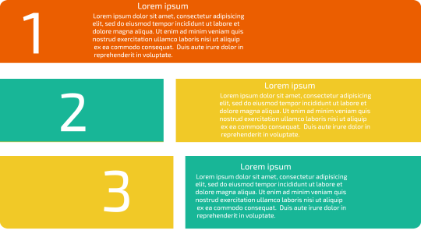
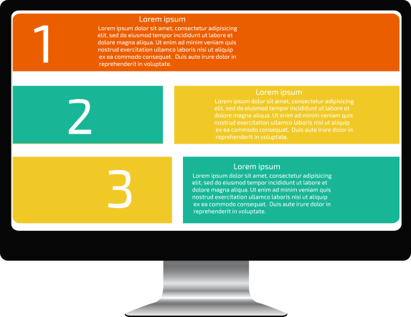
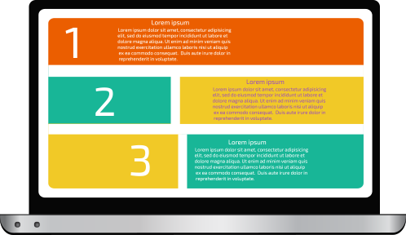
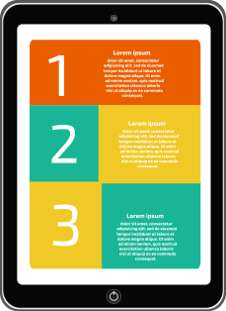
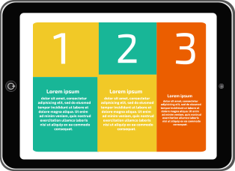

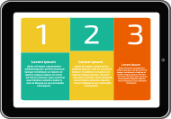
Solution 2: Responsive Design Websites
+
Create 1 Set of Content
Using HTML & CSS3 Media Queries
Same Content, Multi Screens, Same URL

Slide 27
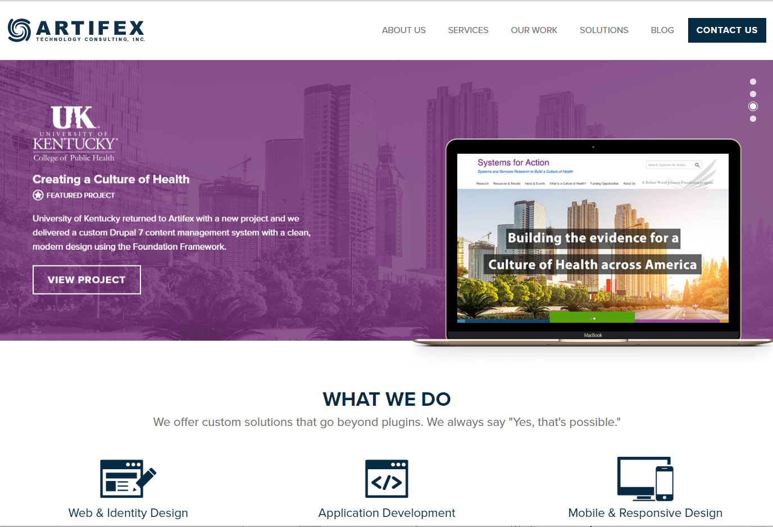


Slide 28
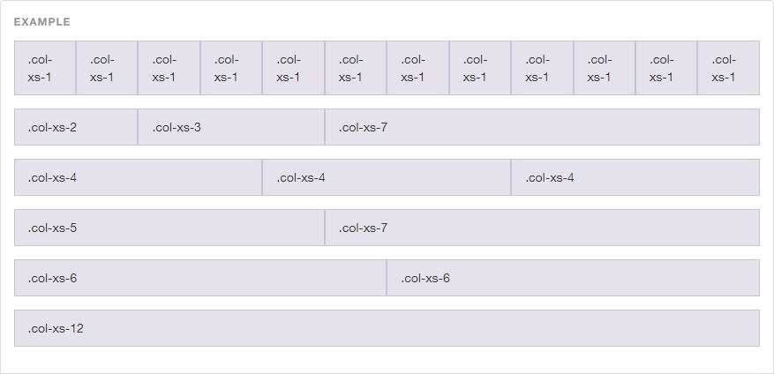
Responsive Design – Grids
Most frameworks, and websites in general utilize a grid based system to handle responsive layouts.
Less prone to inconsistent results than trying to do freeform designs.
Grids give flexibility while still providing structure.

Slide 29
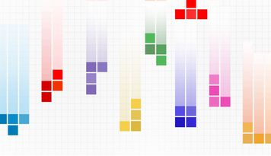
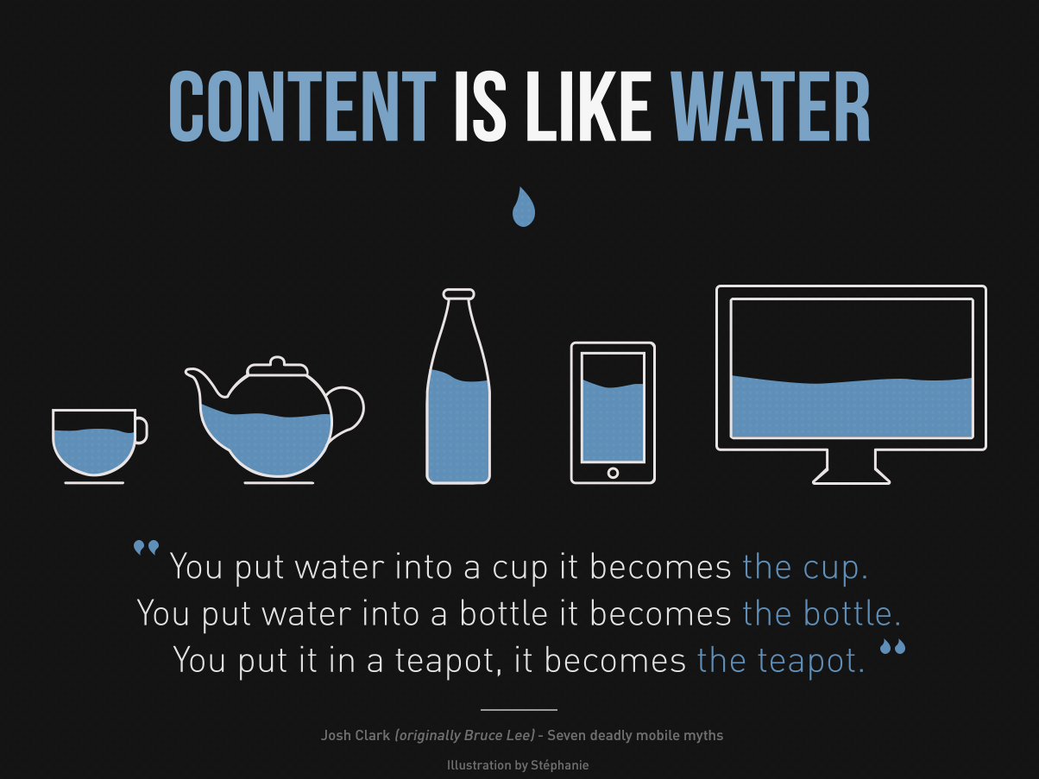

Responsive Design - Grids

Slide 30
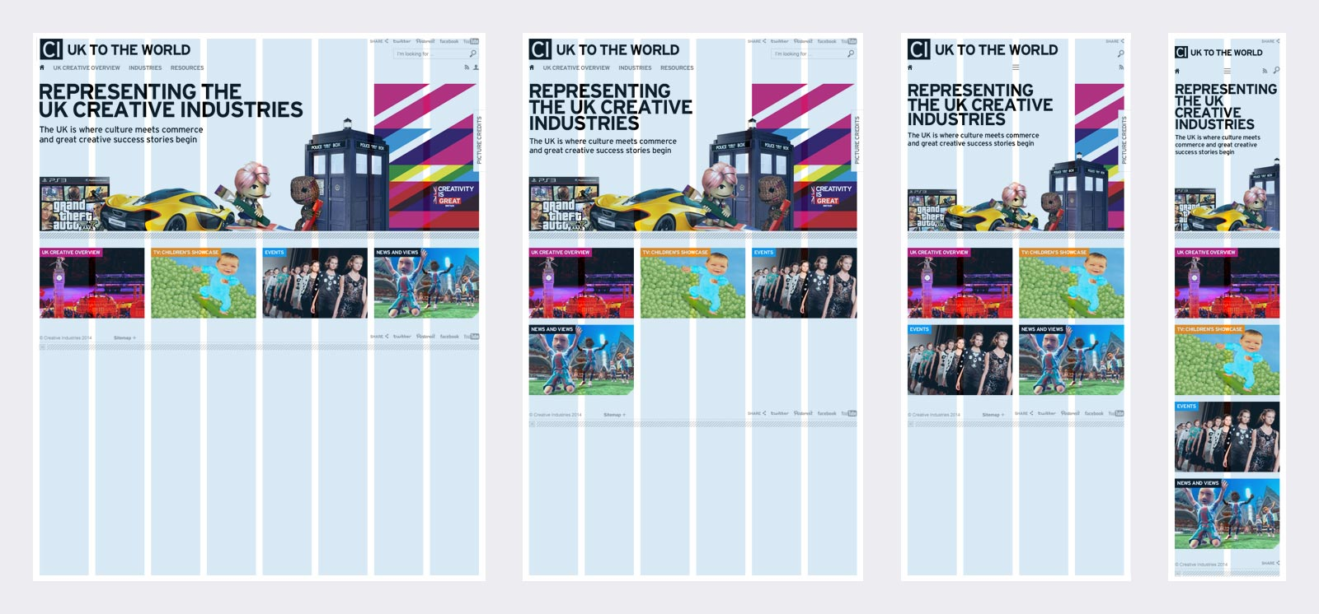
Responsive Design - Grids
http://www.w3schools.com/css/css_rwd_grid.asp

Slide 31
Responsive Design HTML/CSS Frameworks
A framework is a standardized set of concepts, practices and criteria for dealing with a common type of problem, which can be used as a reference to help us approach and resolve new problems of a similar nature.
In the world of web design, a framework is defined as a package made up of a structure of files and folders of standardized code (HTML, CSS, JS documents etc.) which can be used to support the development of websites, as a basis to start building a site.
There are basically 2 types to differentiate: backend and frontend (this distinction is drawn depending on whether the framework is for the presentation layer or the application / logic layer.
The rise of responsive web design techniques, which facilitate the development of websites that can adapt to various resolutions for different mobile and desktop devices, lead to the creation of responsive frameworks.
Don’t Reinvent the wheel!

Slide 32




Responsive Design HTML/CSS Frameworks
Most websites share a very similar structure. The aim of frameworks is to provide a common structure so that developers don’t have to redo it from scratch and can reuse the code provided. In this way, frameworks allow us to cut out repetitive work and save a lot of time.
Frontend, Responsive frameworks usually consist of a package made up of a structure of files and folders of standardized code (HTML, CSS, JS documents etc.)
The common components are:
CSS source code to create a grid: this allows the developer to position the different elements that make up the site design in a simple and versatile fashion.
Typography style definitions for HTML elements.
Solutions for cases of browser incompatibility so the site displays correctly in all browsers.
Creation of standard CSS classes which can be used to style advanced components of the user interface.

Slide 33
Enough Theory. How do I DO stuff?

Slide 34
Common Key Terms and Technologies
HTML / ASP.NET / PHP / Javascript / jQuery - Programming Languages
CSS – Cascading Styling Sheets.
Frameworks – A set of elements, including HTML, CSS, JS and more, which are used to provide streamlined implementation options for developers and designers.
Responsive Web Design - An approach to web design aimed at crafting sites to provide an optimal viewing and interaction experience—easy reading and navigation with a minimum of resizing, panning, and scrolling—across a wide range of devices (from desktop computer monitors to mobile phones).
IDE (Integrated Development Environment) - A set of programming tools for writing applications and websites (source code editor, compiler, debugger, etc.), all activated from a common user interface and menus.
Package Managers - A package manager or package management system is a collection of software tools that automates the process of installing, upgrading, configuring, and removing software packages for a computer 's operating system in a consistent manner.
CMS (Content Management System) - A computer or web application designed to manage digital content using an intuitive GUI without needing to be a developer or web designer.

Slide 35




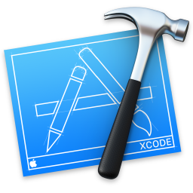



IDE - Integrated Development Environment
IDE (Integrated Development Environment) - A set of programming tools for writing applications and websites.
Source code editor, compiler, debugger, etc.
Kind of like a glorified Text Editor, with extra functionality to do more.
And Many Others

Slide 36

IDE - Integrated Development Environment
Visual Studio Code

Slide 37

What is VS Code?
Visual Studio Code is a streamlined code editor with support for development operations like debugging, task running and version control. It aims to provide just the tools a developer needs for a quick code-build-debug cycle and leaves more complex workflows to other IDEs.

Slide 38



Why VS Code?
Works on multiple platforms:
Windows - 7, 8, 10
Mac - OS X Yosemite, El Capitan, Sierra
Linux - Ubuntu, Debian, Red Hat, Fedora, CentOS
Huge Language Support
Extensions (Plugins)
Java, JavaScript, TypeScript, C, C++, C#, CSS, HTML, Less, Sass, JSON, F#, PHP, Python, PowerShell, Rust, Swift, Text, VB, XML, XSL, YAML, and more…
Library of Community Built Extensions or Create Them Yourself
IntelliSense
Debugging Tools
Built in GIT Source Control
Autocomplete style helpers that appear as you type code
Step through your code for insight into how it’s working
A free source control option; Keeps track of changes to files as you code. *Very Important to Use This*
Free
Download at: https://code.visualstudio.com/

Slide 39
Recommended VS Code Extensions for HTML Projects
HTML Snippets
Full HTML tags including HTML5 Snippets
Copy Relative Path
Copy Relative Path from a File
Path Intellisense
Visual Studio Code plugin that autocompletes filenames
Bower
Create bower.json, install, uninstall, update bower packages, etc
Auto Close Tag
Automatically add HTML/XML close tag, same as Visual Studio IDE
View In Browser
view a html file in system's default browser
HTML Boilerplate
A basic HTML5 boilerplate snippet generator.
Bootstrap 3 Snippets
Bootstrap 3 Snippets for VS Code
HTML CSS Class Completion
Provides CSS class name completion for the HTML class attribute based on the CSS files on your workspace.

Slide 40
HTML / CSS Code Example
Creating a New Website With VS Code

Slide 41
HTML / CSS Code Example
Demo Time:
Creating a New Website With VS Code
Today’s sample code can be downloaded from the Artifex Github repository by using the following link:
Insert bitly link here

Slide 42
Basic HTML Project Structure
Root
---css
---img
---js
---fonts
---bower_components
- Top Level Folder
- All Site Specific Style Sheets or Themes
- Images
All Site Specific JavaScript Files
- Web Fonts
- Bower Packages
PLEASE NOTE: Other frameworks and languages may have additional folders or folder structure requirements.

Slide 43
Basic HTML Project Structure
Why is this important?

Slide 44
HTML / CSS Code Example
Demo Time:
Real World Project Structure

Slide 45
HTML / CSS Code Example
Expanding Our Website Code to be Responsive

Slide 46
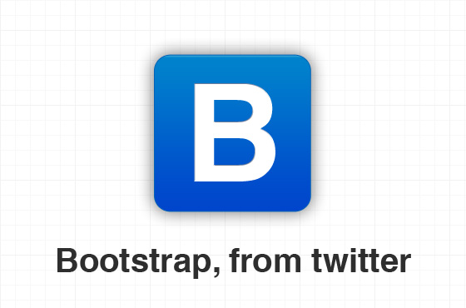
Bootstrap – Overview
Developed by Mark Otto and Jacob Thornton at Twitter
Grid based system to create a responsive design
Customizable
Consistency between developers and designers
Huge Support Community
Easy to learn - http://www.w3schools.com/bootstrap/default.asp
Bootstrap is a free and open-source collection of tools for creating websites and web applications. It contains HTML-and CSS-based design templates for typography, forms, buttons, navigation and other interface components, as well as optional JavaScript extensions. It aims to ease the development of dynamic websites and web applications.
Compatible with the latest versions of the Google Chrome, Firefox, Internet Explorer, Opera, and Safari browsers, although some of these browsers are not supported on all platforms. Since version 2.0 it also supports responsive web design. This means the layout of web pages adjusts dynamically, taking into account the characteristics of the device used.
Download and Explore for Free at: http://www.getbootstrap.com

Slide 47
Bootstrap Structure – Containers, Rows, Columns
Container
Row
Column

Slide 48
Bootstrap Structure – Containers, Rows, Columns
Container:
Bootstrap’s grid system needs a container to hold rows and columns. The container is used to provide a proper width for the layout, acting as a wrapper for the content. Row:
A row acts like a wrapper around columns.
A row spans from the left edge to the right edge of the container element. It is created by adding the class .row to a block level element inside the container.
Column:
Each row is comprised of columns. A row can be broken up into up to 12 columns, and columns can be defined to span 1 or more of these 12 column slices.
You can specify different columns for different size screens.
Container
Column
Row
You can have multiple containers per page.
You can nest rows & columns to create more complex layouts

Slide 49
HTML / CSS Code Example
Adding Bootstrap to our Project in VS Code

Slide 50

Bower Package Manager
Work Smarter, Not Harder
Front End Package Manager - it will manage any packages, including JavaScript, HTML, CSS, or images. In this case, a package means any encapsulated third-party code. Some people would call it the client side package manager while NuGet is more server side package
The important thing to note here is that Bower is just a package manager, and nothing else. To actually *do* anything you need to use it to install packages
Huge library of packages available online
Speeds up development time
Downloads dependencies
Explore More: https://bower.io/

Slide 51
Bower Packages
Today we will be using the following Packages:
Font-awesome - Full suite of pictographic icons for easy scalable vector graphics on websites
Bootstrap - Front-end framework for developing responsive, mobile first projects
jQuery
Other Highly Recommended Packages:
Modernizr - JavaScript library that detects HTML5 and CSS3 features in the user’s browser.
jquery-validation -
jquery-ui

Slide 52
Bootstrap Code Demo…
Demo Time:
Creating a Responsive Website With Bootstrap
Today’s sample code can be downloaded from the Artifex Github repository by using the following link:
Insert bitly link here

Slide 53
Moving Beyond the Static Website with ASP.NET
ASP.NET is a server-side web application framework designed for web development to produce dynamic web pages. It was developed by Microsoft to allow programmers to build dynamic web sites, web applications and web services.
ASP.NET flavors:
Web Forms
MVC
Core 1 – New - Open Source (Similar to MVC 5)
Languages:
C#
VB / VB.NET
F#

Slide 54
Moving Beyond the Static Website with ASP.NET
Requirements:
WebForms, MVC 5
Core 1
Hosting: IIS or IIS Express (Only for Testing)
IDE: Visual Studio
Platform: Windows (Mono on Linux)
Hosting: Kestrel
IDE:

Slide 55
Moving Beyond the Static Website with ASP.NET
Demo Time:
Creating an Actual Site with VS Code, ASP.NET, & Bootstrap
Today’s sample code can be downloaded from the Artifex Github repository by using the following link:
Insert bitly link here

Slide 56
Common Key Terms and Technologies
HTML / ASP.NET / PHP / Javascript / jQuery - Programming Languages
CSS – Cascading Styling Sheets.
Frameworks – A set of elements, including HTML, CSS, JS and more, which are used to provide streamlined implementation options for developers and designers.
Responsive Web Design - An approach to web design aimed at crafting sites to provide an optimal viewing and interaction experience—easy reading and navigation with a minimum of resizing, panning, and scrolling—across a wide range of devices (from desktop computer monitors to mobile phones).
IDE (Integrated Development Environment) - A set of programming tools for writing applications (source code editor, compiler, debugger, etc.), all activated from a common user interface and menus.
Package Managers - A package manager or package management system is a collection of software tools that automates the process of installing, upgrading, configuring, and removing software packages for a computer 's operating system in a consistent manner.
CMS (Content Management System) - A computer or web application designed to manage digital content using an intuitive GUI without needing to be a developer or web designer.

Slide 57







Content Management Systems

Slide 58
Content Management Systems
Why is this Important?
Why do I need to know HTML / CSS if I’m using a CMS?

Slide 59
Content Management Systems
Basic Formatting Available using WYSIWYG Editor
Most also have a “Text”, “HTML”, or “Source” Mode

Slide 60
Content Management Systems
Some CMS’s also allow you to access and modify the files from within the admin
This means you can create and modify however you wish

Slide 61

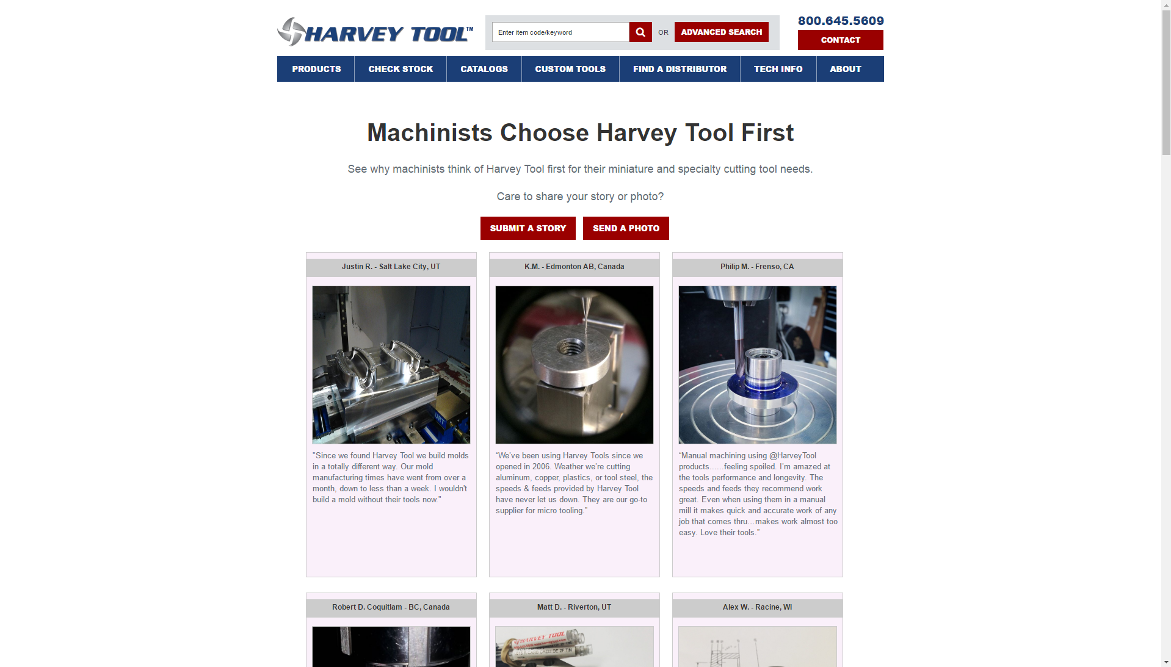
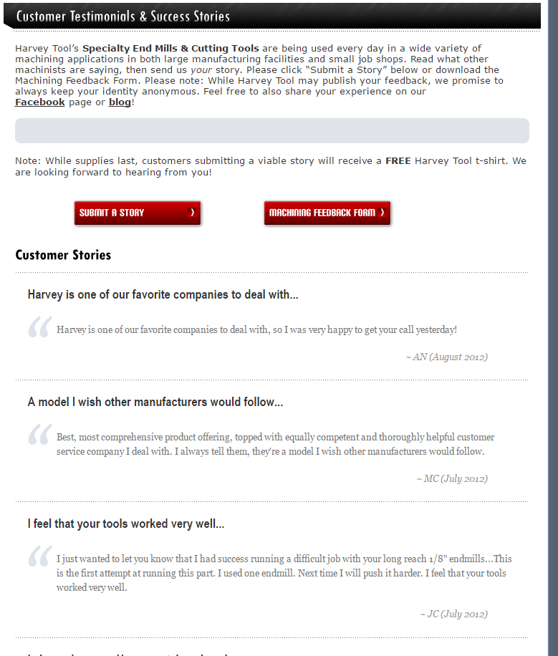
Content Management Systems

Slide 62

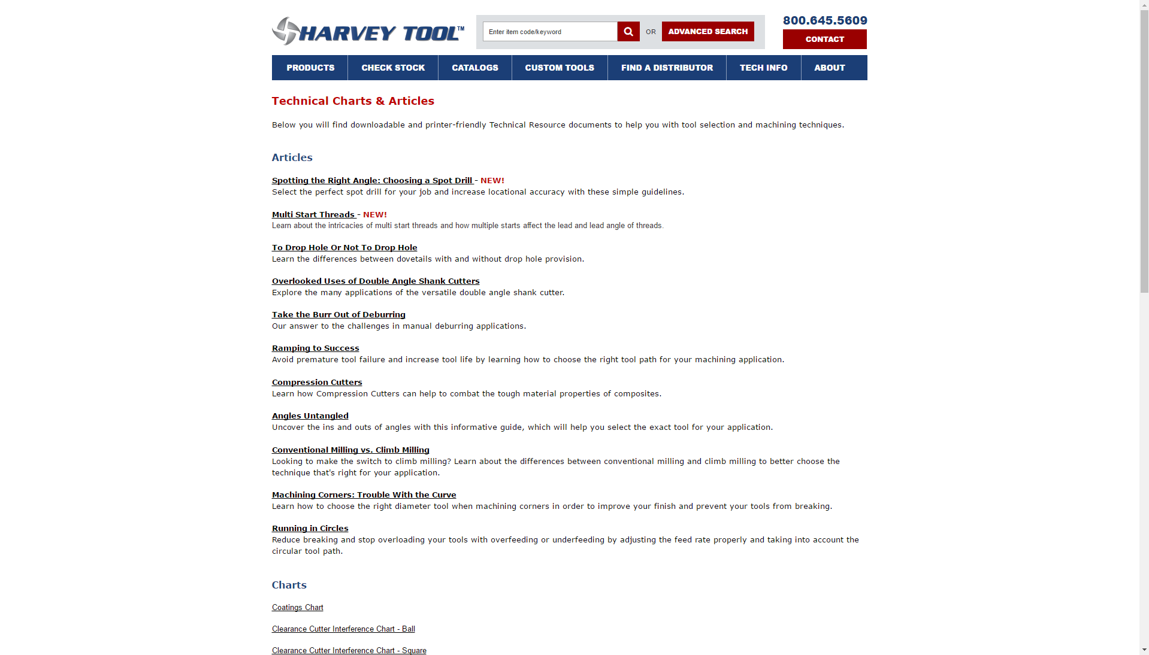
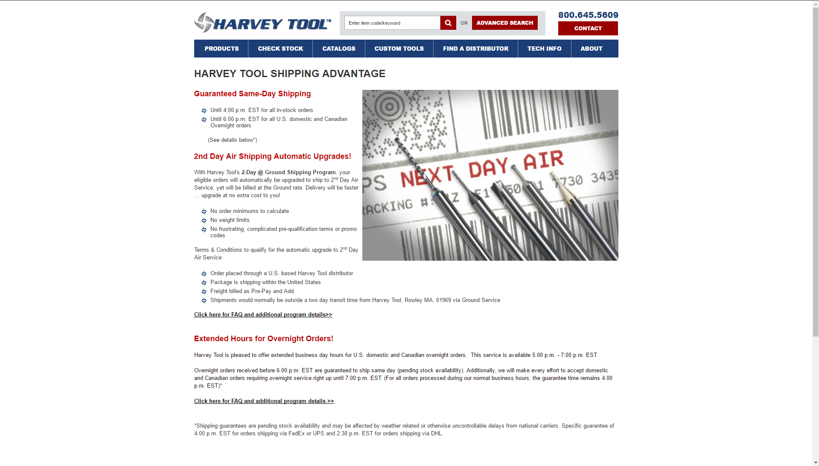
Content Management Systems

Slide 63
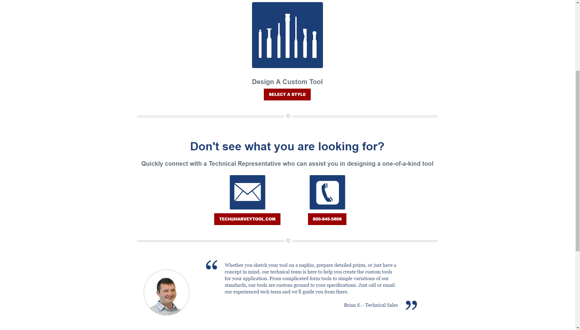
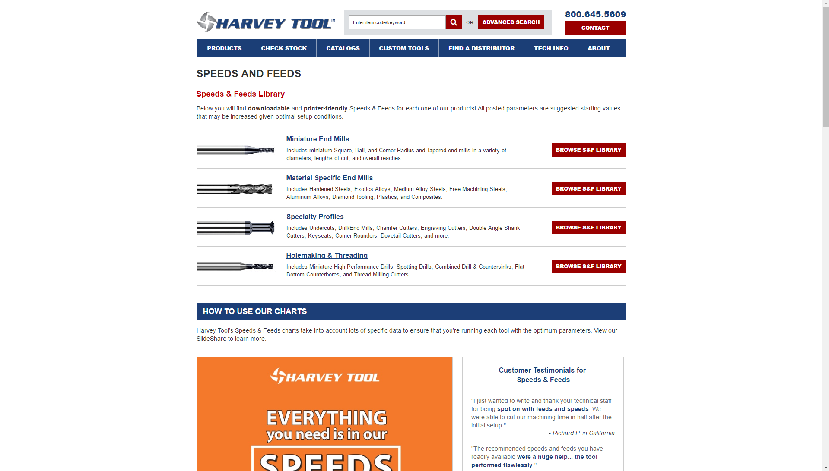
Content Management Systems

Slide 64
Content Management Systems
Why is this Important?
Why do I need to know HTML / CSS if I’m using a CMS?
Understand how things work
Modify / Extend / Customize
Make it your own

Slide 65
Questions?
Interested in Talking More or Have A Question?
Matt Charron
Paul Duffy
Email: MCharron@ArtifexTech.com
Twitter: @TheMattCharron
Email: PDuffy@ArtifexTech.com
Twitter: @ThePDuffy3
Blog: bit.ly/paulduffy

